Slide 1
An Chianfhoghlaim le Croí Emer Nic an Fhailí agus Mary Uí Dhaimhín Coláiste Feirste

Slide 2
Ceannaireacht
le Croí:

Slide 3
Ceannaireacht
Straitéisech:

Slide 4
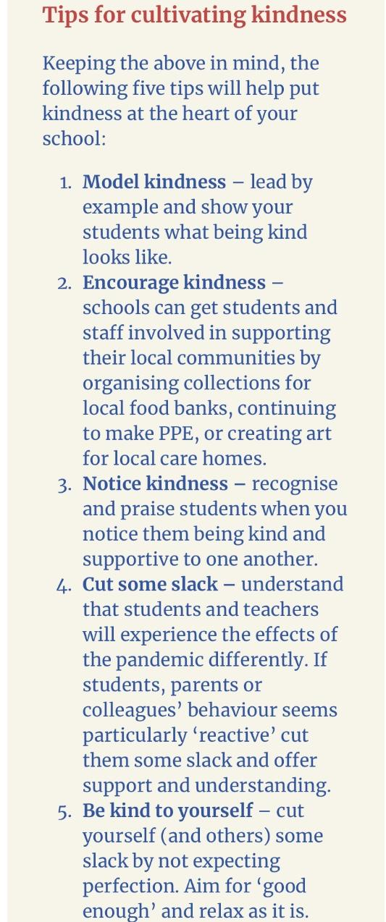
Na Meicníochtaí

Slide 5
Cad é is mian linn do dhaltaí an Choláiste?
Is Gael mé
Grá agus Sonas
Muinín agus Meas
Is fiú mé
Is Pobal Sinn

Slide 6
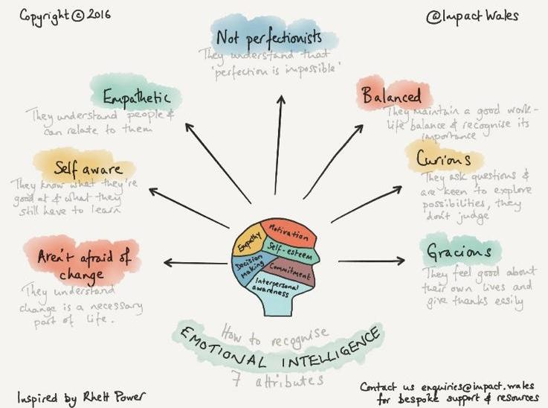
Notes:
Scileanna
Athléimneacht
Aisiríoch

Slide 7
Ag Ullmhú
don Dara Dianghlasáil
ISEF;
Restart;
Pleanáil FBS;
Tosaíochtaí aontaithe – cad é ba mhaith linn go géarthréimhseach (gach lá) go fadtréimhseach (ag deireadh na dianghlasála)
Téamaí lárnacha – monatóireacht, cuntasacht,
Attention to detail and immediate follow up.
Taighde:

Slide 8
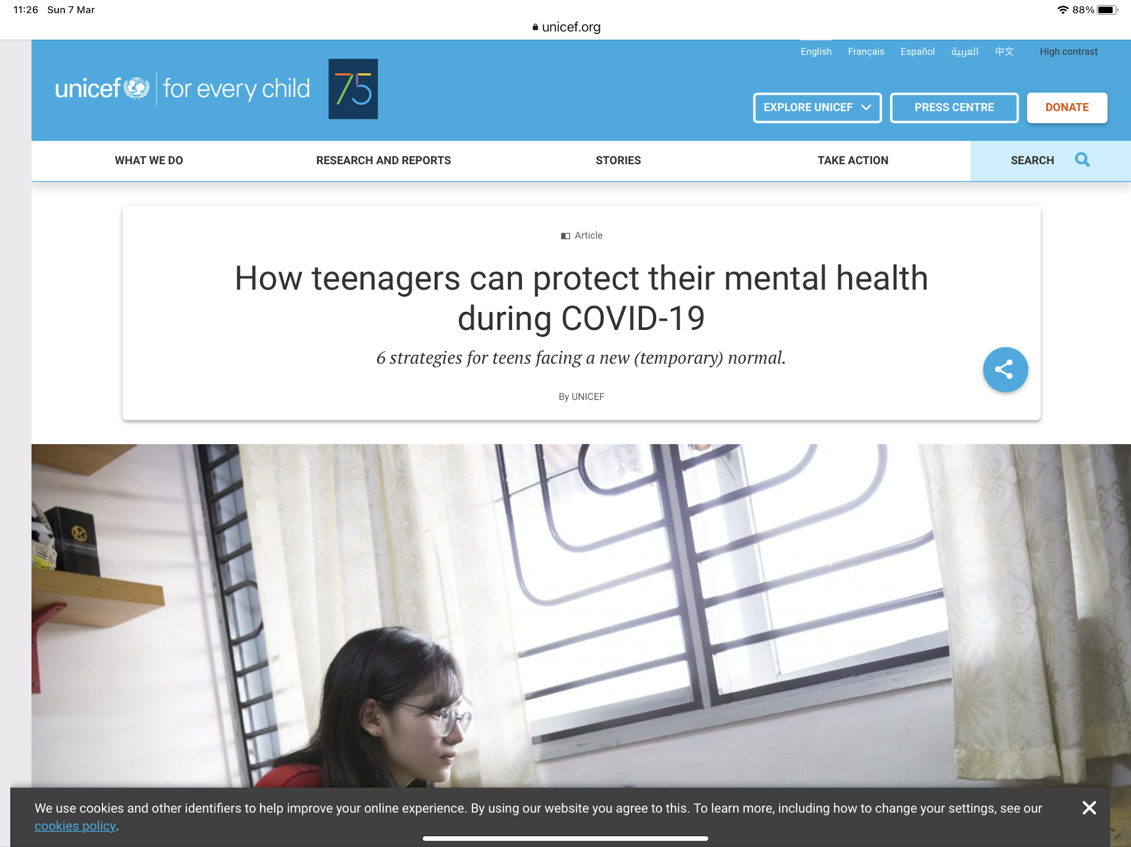
Taighde:

Slide 9
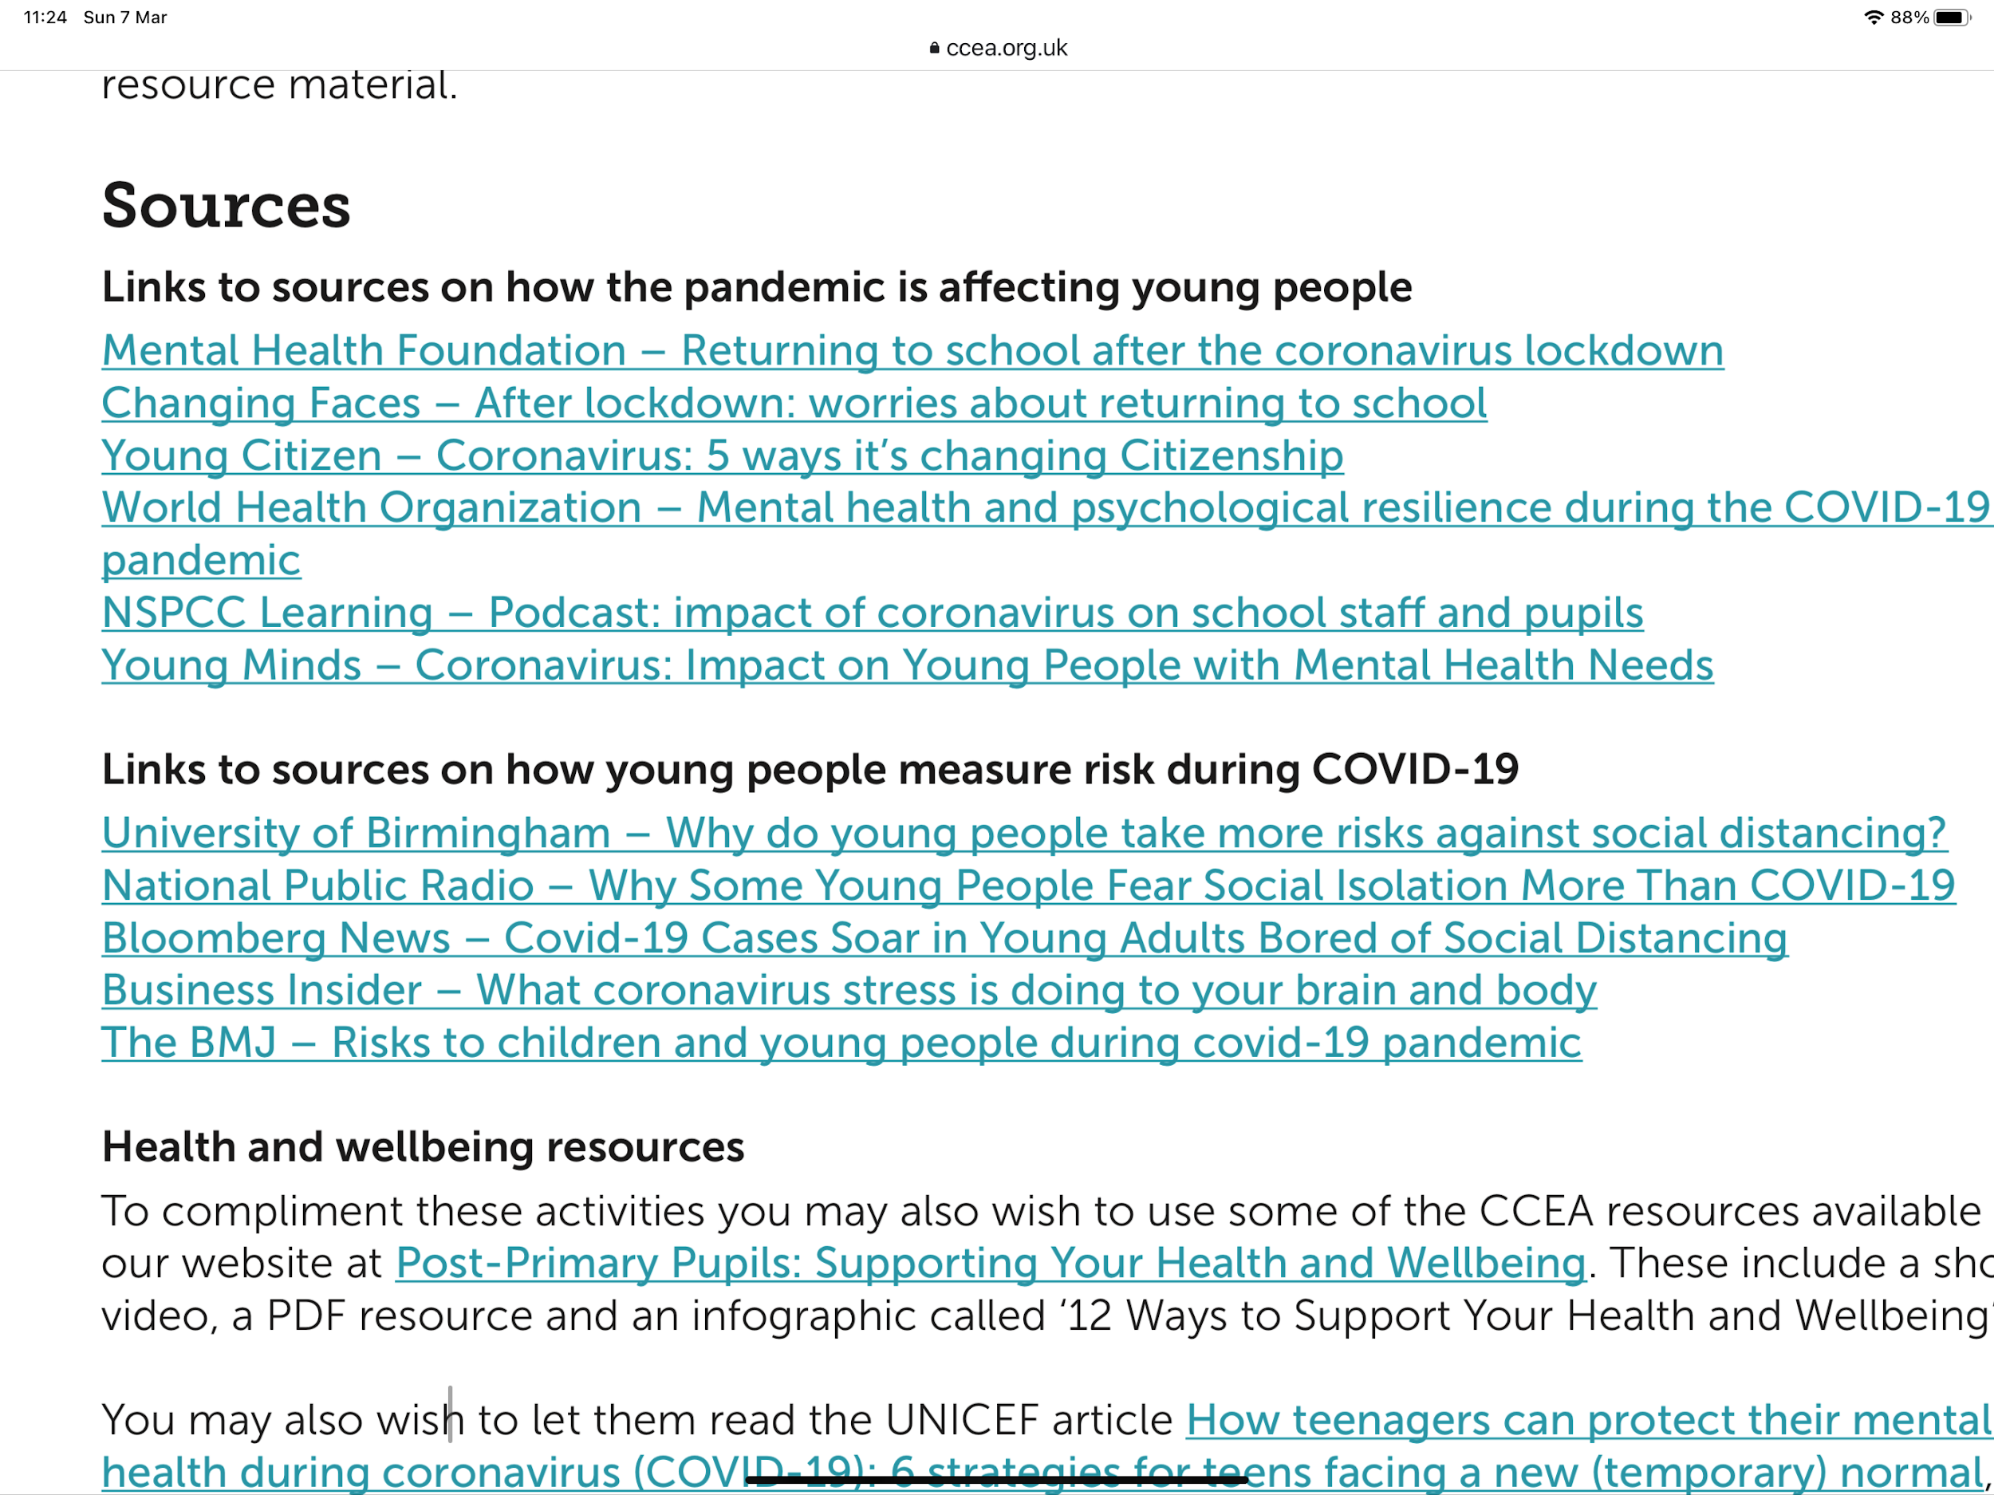
Úsáid na n-Achmhainní

Slide 10
Grá dár ndaltaí = déanaimid plé orthu ó dhubh go dubh
Cumarsáid foirne rí-thábhachtach chun monatóireacht agus idirghábháil a dhéanamh mar is ceart.
Cruinnithe/cumarsáid roinne
Cruinnithe/cumarsáid CB
Cruinnithe FCS/CnabP
Cumarsáid le tuismitheoirí: Parent App

Slide 11
Pleanáil Eanáir – Márta
Ceangal lárnach leis an PFS;
Tosaíochtaí:
Cumhdach Páistí - sampla le teacht
Tinreamh - sampla le teacht
Sabháilteacht ar Líne
An Ghaeilge
RSO
Forbairt Phearsanta
Gael Cheannaireacht agus Guth na nDaltaí
THAW
Notes:
seo sampla den chuma a bhí air seo sa phlean Sá chéad sleamhán eile:

Slide 12
Samplaí d’fhoirmeacha ar an mhonatóireacht

Slide 13
Cumhdach Páistí/An Dalta Leochaileach - CIALL
An Dalta Leochaileach - CIALL CF
Ró-ghineáralta;
Shainmhínigh muid an tuiscint dúinn féin:
11 chatagóir:
Treoir don fhoireann:
+add comment;
Monatóireacht na foirne CnbP

Slide 18
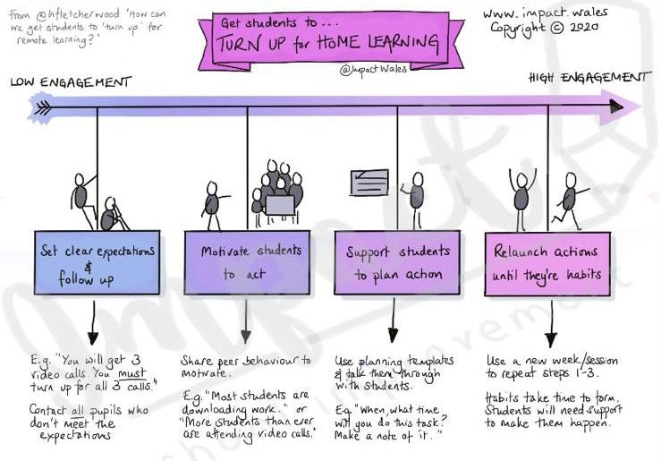
Ionchais

Slide 19
Teanga na
Cumarsáide

Slide 20
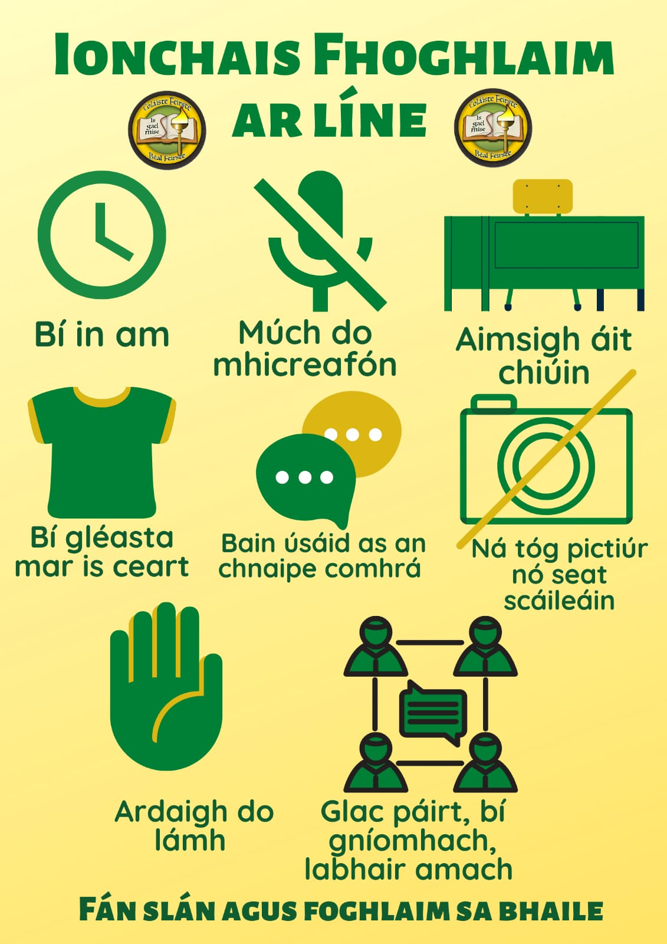
Teanga na
Cumarsáide

Slide 21
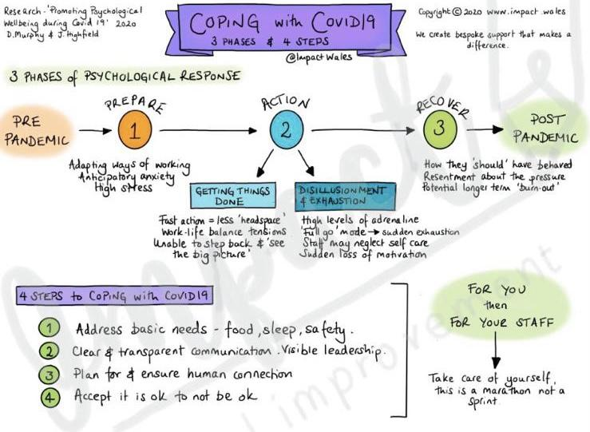
Cur Chuige:

Slide 22
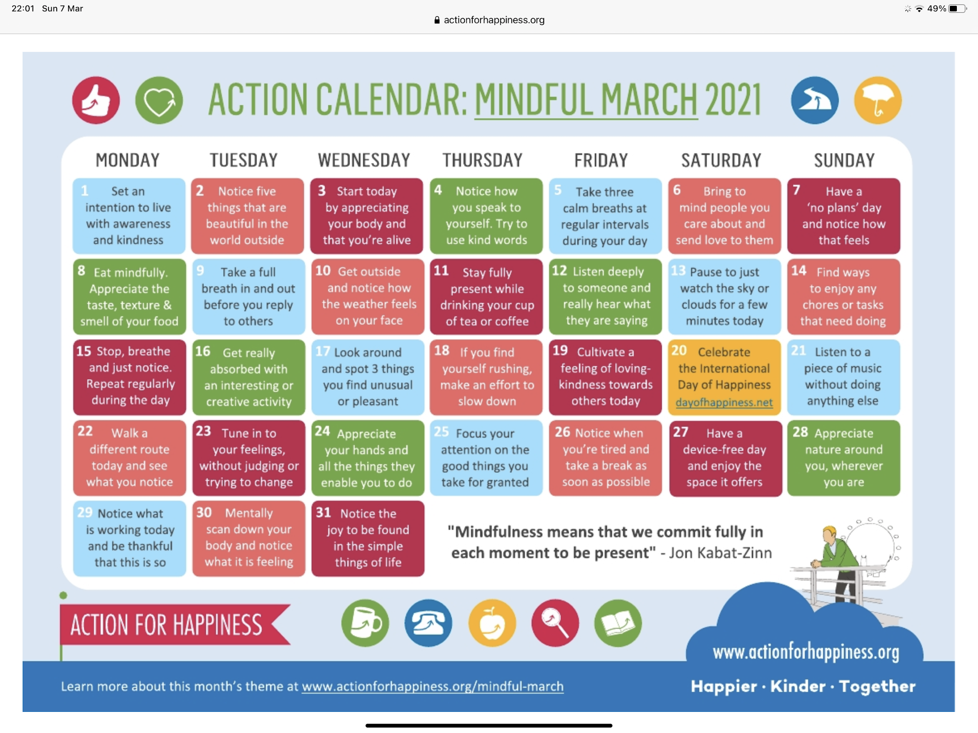
Meabhairshláinte:

Slide 23
Meabhairshláinte:

Slide 24
Ceistneoirí d’Fhoireann na Scoile:

Slide 29
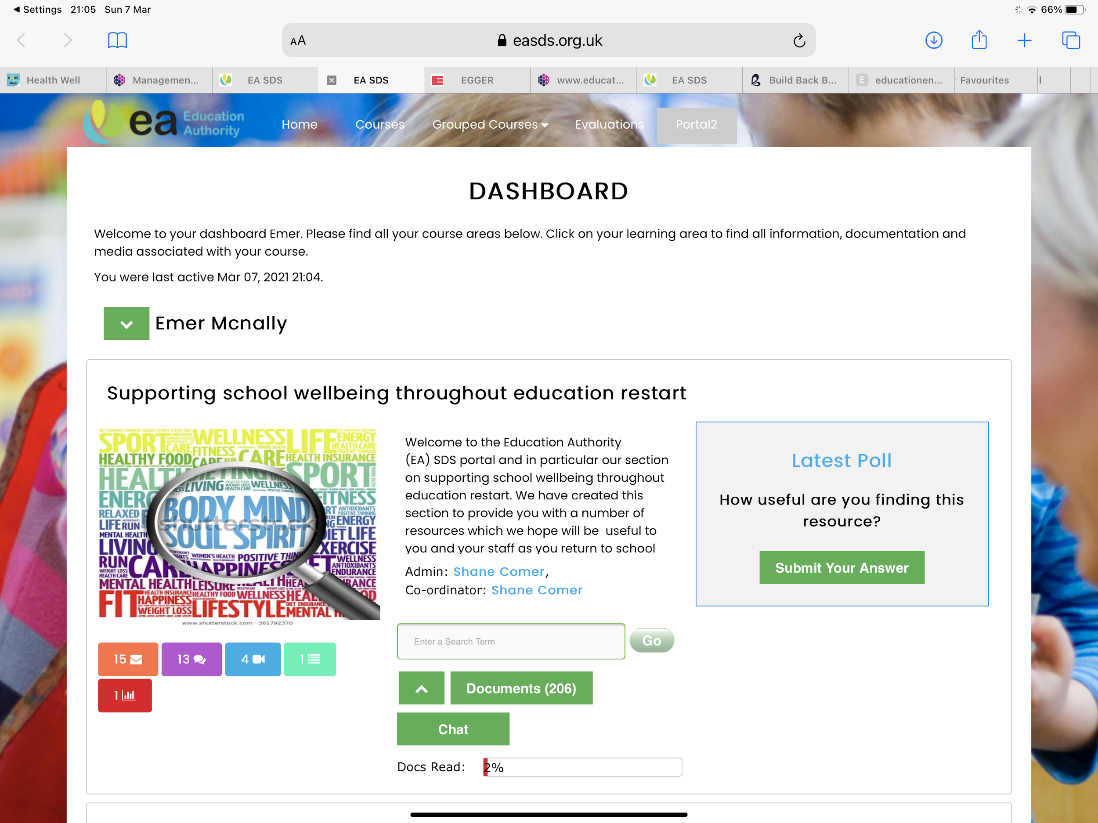

Slide 31
Ceistneoir RSO
Soiléiriú ar an ról a bhí ag c..tóir + dalta le ráiteas;
Léirigh anailís riachtanais GO gasta go raibh tacaíocht de dhíth ó staid 2 ar aghaidh. C..tóirí nach dtiocfadh leo bheith ar scoil, d’oibrigh siad le daltaí ar GC/guthán srl…

Slide 32
Aischothú ó thuismitheoirí...

Slide 33
Both myself and ***'s dad continue to work full time. I have the additional stress of being redeployed to adult nursing world after spending over thirty years in paediatric nursing, and many of the patients I care for are covid positive. This brings additional anxieties for *** with his OCD etc and hence he avoids interactions with me. Without the direct cúntóir ranga support ***'s learning would be in jeopardy. I feel daily interactive sessions with *** for his statemented hours are a necessity to enable and promote learning for *** if he is to attain academic achievement and enter adult world with appropriate literacy and numeracy skills

Slide 34
Stress levels are lower than norm. It has eased my son's anxiety a great deal. He is unable to adapt to home schooling after numerous attempts throughout this pandemic. He needs one on one support constantly therefore relying heavily on it. Any change to routine causes great distress to my son which affects him for long periods and can be difficult to bring him back round. His classroom assistant has supported him throughout and this can be seen in both my son's mental health and his school work.

Slide 35
Ciaran has been an absolute GOD SEND for ++++ especially with covid he has went above and beyond I'll never be able to thank him enough for all he does for ++++ and I know ++++ really looks up to him.

Slide 36
I meant to drop you guys an email to let you know that he has been really positive regarding this whole lock down schooling, something I never expected at the beginning of all this. He seems to be really enjoying it and his confidence has grown since Christmas with over all schoolwork.
We really appreciate everything yourself and Áine have been doing.

Slide 37
No honestly she's been a lifesaver with this home schooling took so much pressure of me! Very confidant young woman! Just want to show her how much she's appreciated!
Thank you for organising this!

Slide 38
ISEF – cumasú foirne
Cúntóirí ranga – ceistneoir ar an chineál treanála a bhfuil suim acu ann.
Fionntán Ó Mealláín - FCSN (Tacaíocht do thuismitheoirí chomh maith)
Treanáil ACES – Ag cumasú na cúntóirí le plé leis na daltaí atá thíos leis maidir le cúrsaí sa bhaile

Slide 39
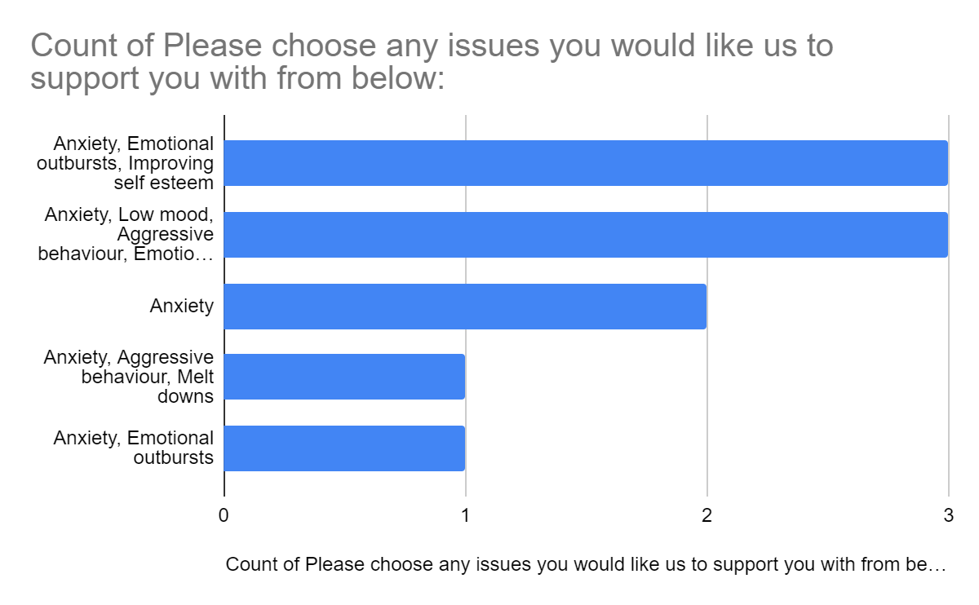
Cúmasú an tuismitheora

Slide 40
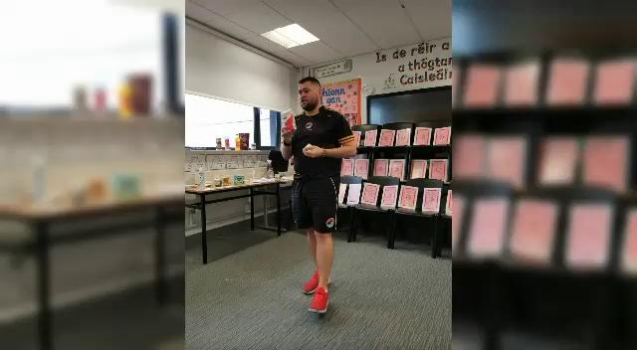

Slide 41
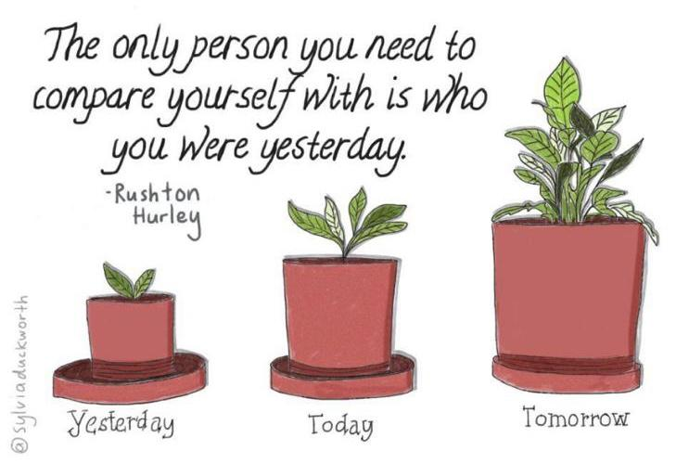
An chéad chaibidil eile - change the narrative

