Slide 1


Mathematical Calculation Strategies
24 Márta 2021
3:45pm – 4:30pm
le Robert Thompson agus Ashleigh Maw

Slide 2
What is fluency in mental calculation?
FLUENCY
EFFICIENCY
ACCURACY
FLEXIBILITY
An efficient strategy is one that the pupil can carry out easily and quickly without getting bogged down with too many steps or losing track of the logic of the strategy
Accuracy depends on knowledge of number facts and other important number relationships, careful recording (when necessary) and checking results
Flexibility requires the knowledge of more than one approach to carrying out a particular calculation. Pupils need to be flexible in order to choose an appropriate strategy for the numbers involved
Notes:
ETI use the word ‘flexibility’ in relation to mathematical calculation. I would see the word ‘fluency’ as a more holistic development of calculation which is the reason for the title of today’s course.
‘Speed’ in calculation is part of efficiency and accuracy and needs to be developed sensitively without putting children under undue pressure and causing them to develop anxieties about Maths.

Slide 3


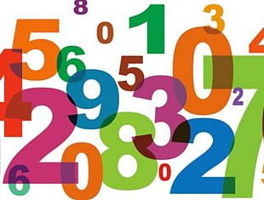
Mental Maths Starter

Slide 4
Mental Calculation
There are seven strategies for mental calculation.
70 times 4
is 280
Can the pupils in your school identify and employ these strategies by the time they reach Key Stage 2?
Are all the teachers in your school aware of the seven strategies and are they actively teaching them?

Slide 5
The
Seven Strategies for
Mental Calculation
Re-ordering
Counting on/
Counting back
Partitioning
Rounding
And
Adjusting
Using
Equivalence
Inverse Operations
Using Factors
Notes:
Five of the strategies begin in foundation stage : Counting on/back, Partitioning, Rounding and Adjusting, Re-Ordering, Inverse Operations (+ and -)
At KS1 pupils start to use ‘Using Factors’
At KS2 ‘Using Equivalence’ is introduced.

Slide 6
Counting on/
Counting back
When adding and subtracting count on in ones, twos, tens, hundreds, halves, tenths, etc

Slide 7
Re-ordering
Re-arrange numbers to make the calculation easier; look for components of 10, doubles, near doubles, etc.
Calculate the following:
13 + 8 + 7 + 4 + 9
One method : 13 + 7 = 20 (components of 10 extended to 20)
8 + 9 = 17 (near doubles)
20 + 17 = 37
37 + 4 = 41
Notes:
This strategy relates to the commutative properties of addition and subtraction and obviously does not work for subtraction and division.

Slide 8
Partitioning
Keep one number intact and partition the other
JUMP STRATEGY
57 + 26 = 57 + 20 + 6 75 – 36 = 75 – 30 - 6
Partition both numbers then recombine
SPLIT STRATEGY
46 + 37 =
40 + 30 + 6 + 7 =
70 + 13
Partition numbers in a way that allows bridging through 10
47 + 6 = 47 + 3 + 3
53 – 8 = 53 – 3 - 5
Notes:
Maths Recovery has two separate names for the Partitioning Strategy
Jump strategy – keep first number intact and partition second number (can be demonstrated on the empty number line)
Split Strategy – partition both numbers and recombine (not suitable for recording on empty number line)

Slide 9
Rounding and Adjusting
When adding near doubles use doubles and adjust; when calculating round to the nearest 10/100 and adjust; when multiplying use known number facts and adjust.
round to the nearest 10 and adjust
(usually for numbers ending in 8 or 9)
OVER-JUMP STRATEGY
64 + 29 = 64 + 30 – 1
51 – 18 = 51 – 20 + 2
When adding near doubles use doubles and adjust
18 + 16 = double 16 add 2 OR double 18 subtract 2
Notes:
Potentially this strategy could become three separate strategies. I like to reserve ‘rounding and adjusting’ for calculating with numbers close to but just below the decuple / centuple.
Two other strategies could be ‘Use doubling and halving’ and ‘Use known number facts’

Slide 10
Inverse Operations
Use the relationships between addition, subtraction, multiplication and division.
e.g. 100 – 87 becomes 87 + = 100
225 ÷ 25 becomes 25 x = 225

Slide 11
Using Factors
When calculating use doubling and halving; when multiplying or dividing use multiples of 10 as a factor of one of the numbers; when multiplying or dividing by 50 or 25 use multiplication or division by 100.
e.g. 47 x 4 = 47 x 2 x 2 = 188
16 x 50 = 16 x 100 ÷ 2 = 800

Slide 12
Using
Equivalence
When calculating, comparing or ordering select the appropriate form of fractions, decimals or percentages (KS2)
Find 25% of £16.60
25% is equivalent to ¼
Half of £16.60 is £8.30 and half of £8.30 is £4.15

Slide 13
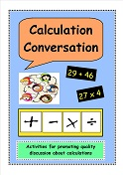


Calculation Conversation
Comparing levels of difficulty in calculations

Slide 14
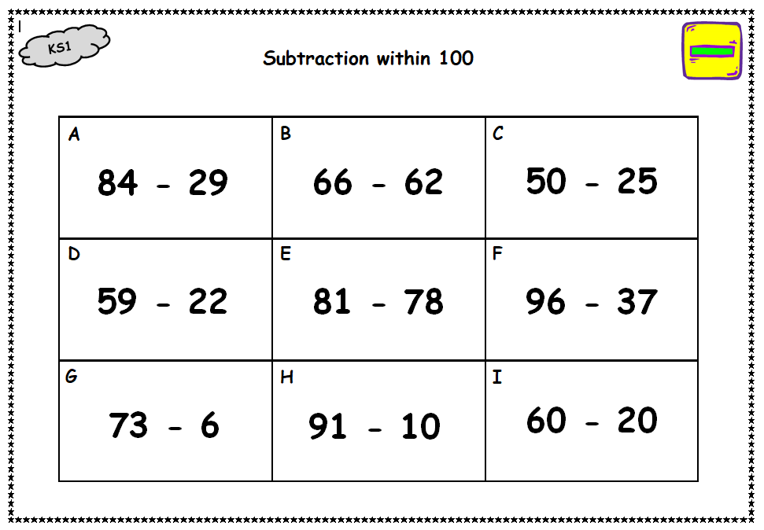

Slide 15
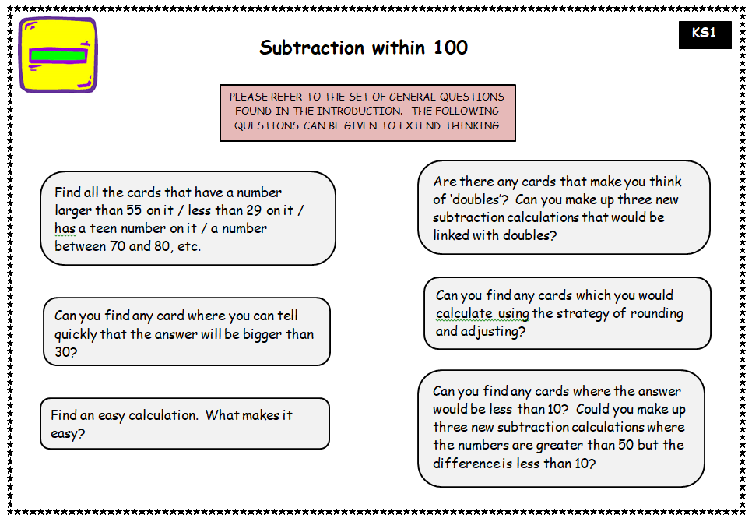

Slide 16
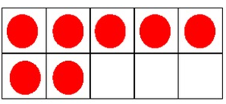
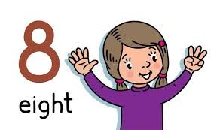
Structuring Numbers
  The learner:
  - can combine and partition numbers without counting-by-ones.
  - uses knowledge of doubles and the 5 and 10 structure of numbers.
  Teaching involves:
  finger patterns
  spatial dot patterns
Notes:
So for example being able to work out 8+5=13, by looking at 8 and knowing it takes 2 more to make 10, that 5 is the same as 2 and 3. if we use the 2 to add to the 8 to make 10 then it will leave 3, and that 10 +3 is 13. This is as opposed to counting on 8, 9, 10, 11, 12, 13, or using knowledge of the story of 13.
Many of the resources promoted by Maths Recovery will help provide children with a flexible way of structuring and thinking about numbers not only in Foundation Stage but at all levels.

Slide 17
Key number combinations and partitions
Doubles to ten; 1+1, 2+2, 3+3, 4+4, 5+5 and halves; 2 is half of 4, 3 is half of 6
Partitioning numbers 2 to 5. Partitioning 2 into 1+1 and 3 into 1+2 and 2+1 and so on.
Combinations with 5; 6=5+1, 7=5+2 …
Partitioning numbers 6 to 10. Partitioning 6 into 5+1, 4+2, 3+3…and so on. Similarly for 7 to 10 with particular emphasis on the partitions of 10
Combinations with 10; 11=10+1, 12=10+2 …
Doubles to twenty; 6+6, 7+7, 8+8, 9+9, 10+10…and halves; 8 is half of 16, 10 is half of 20
Notes:
There are key combinations and partitions which children need to work on to develop the structure of numbers.
Focusing on these key combinations and partitions is arguably more important than laboriously going through ‘the story of 11’, ‘the story of 12’ week by week in P2

Slide 18
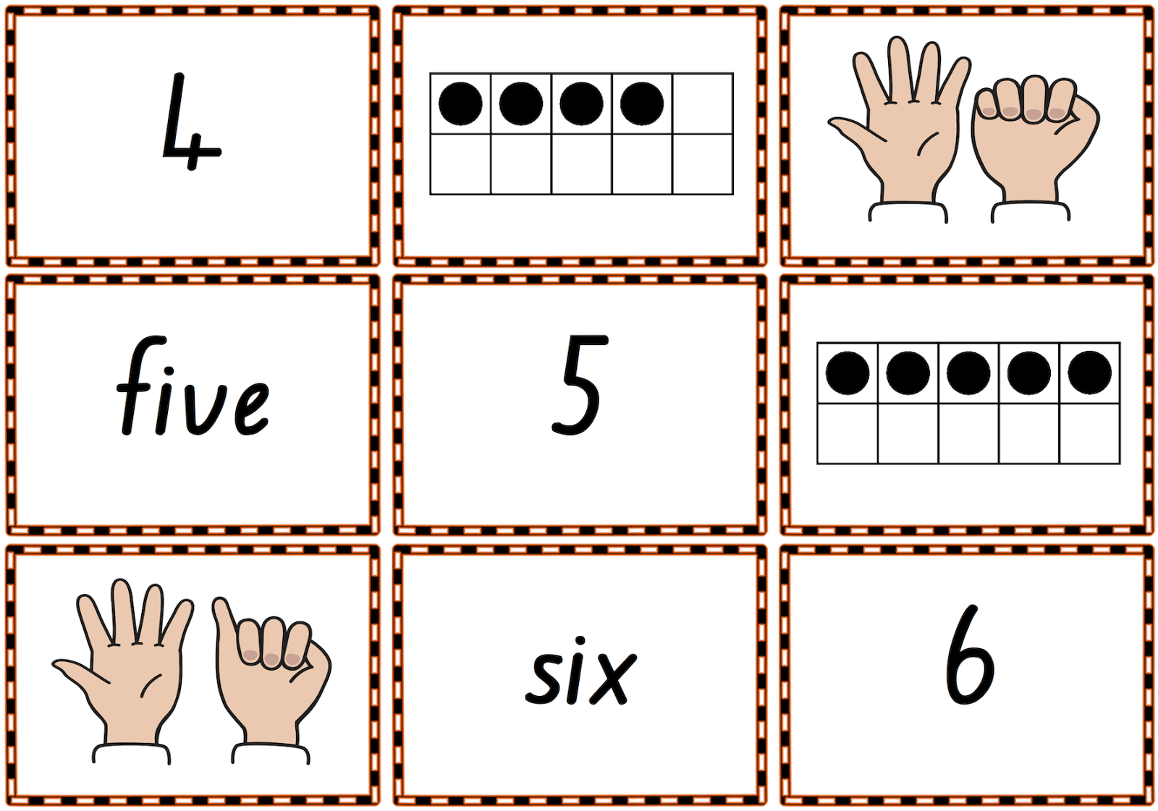

Finger Patterns
  Progression in learning:
  Make 1 to 5 (show me …) Look for:
  ‘Read’ 1 to 5 (what can you see?)
  Make 6 to 10 (one hand showing 5)
  ‘Read’ 6 to 10
  make combinations to 5 and then 10
  (teacher shows 2, children show 3/teacher shows 4, children show 6)
  Make and ‘read’ doubles e.g. 3+3, 5+5
  Bunny ears (make patterns without looking)
  Show the same number in different ways
Growing
Throwing
Notes:
As an adult, do you ever use fingers to help you count or are your skills more sophisticated? (My own example of working out the date a week later when bridging the month.)
The use of finger patterns in counting, addition, subtraction and so on is widespread, being used in many cultures by adults as well as children.
In the past it was discouraged but the current view is that it supports the development of more sophisticated strategies. You may notice children hiding their fingers or being embarrassed about using fingers to count.
Observe if children ‘grow’ or ‘throw’ the pattern. ‘Throwing’ the pattern indicates a higher level of sophistication. Do the children need to look at their hand when making the pattern. If they don’t that also indicates a higher level of sophistication.
Begin by ‘making’ then ‘reading’ finger patterns
Work within 5 then when children can ‘throw’ the pattern move on to 6 to 10
Build the numbers to 10 as 5 on one hand and the rest on the other hand
Distance the setting with ‘Bunny Ears’
Make finger patterns based on doubles
How fast can children make combinations to 5. Teacher holds up 2 fingers, the child holds up 3 to make 5 altogether
Showing the same number in different ways
Important to develop non counting-by-one strategies. Adding two numbers in the range 1 to 5 (e.g. 3 and 4, hold up 3 on one hand and 4 on the other hand, raise one finger on the 4 hand and lower one finger on the 3 hand to make the more familiar pattern of 5+2)

Slide 19
The Five Frame
Start empty, count the spaces
Children fill with counters from left to right, no gaps. Ask:
how many dots, how many spaces?
Use two colours of dots to show components of 5. Ask:
How many blue, how many red, how many altogether?
Use cards to show the children 5 frames to describe. When they are more confident show the cards only for about 1 second – ‘flashing’ before asking them to describe what they saw.
Notes:
A ‘five-frame’ is a rectangular arrangement of 5 empty squares in a line.
When making numbers on the five-frame establish that the patterns for 1-5 are always starting on the left and without leaving any gaps
Display each five-frame briefly and ask – how many dots?
Teacher holds up a 5-frame and the pupil has to find the 5-frame that will make 5 altogether
Call out a number e.g. 1 – the pupil has to find the 5-frame that goes with it to make 5

Slide 20
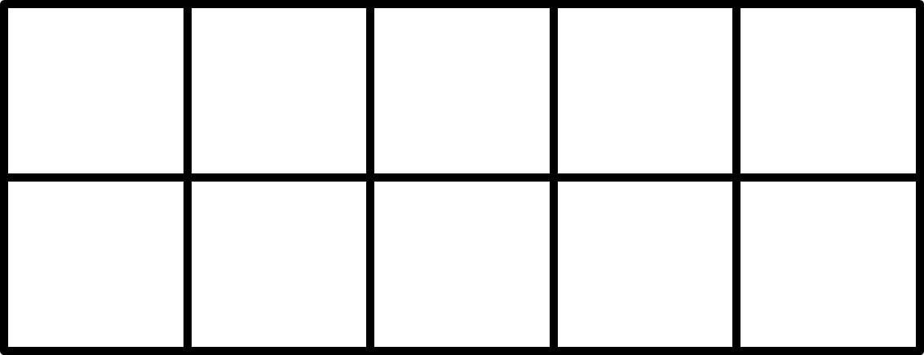
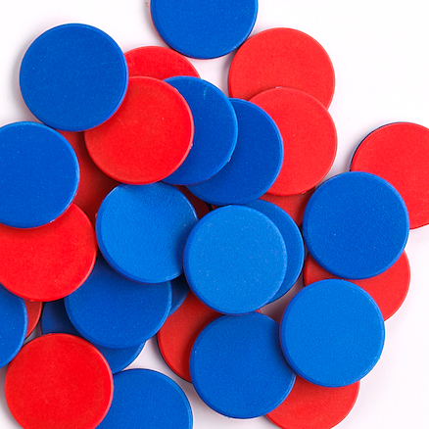
The Ten Frame
Start empty, count the spaces
2 different ways to represent numbers: five wise and pair wise
Work with one type until the children are confident before moving onto the other type.
Be consistent with colour of counters.
7 FIVE WISE
7 PAIR WISE
Notes:
Ten-Frame
Work with 2 sets of 10-frames : initially 5-wise and then pair-wise
How many do you see?
Work with a blank ten frame and counters. Ask children to show a specific number
Flash the 10-frame – how many did you see?
And how many more to make 10?
Partitions of 10
Combinations in the range 1-10. How many red dots? How many blue dots? How many altogether? How many more to make 10?
Activity 1 : Blank ten frame and counters. I will call out a number – you show me on the 10-frame how many more are needed to make 10
Activity 2 : Memory Game : Place out two sets of 10-frames face down. Turn over one of each colour. If they match keep the cards, if they don’t match turn them upside down again.

Slide 21
The Ten Frame
Components of 10
6 and 4
Components of 10
2 and 8
Notes:
Partitions of 10
Combinations in the range 1-10. How many red dots? How many blue dots? How many altogether? How many more to make 10?
Activity 1 : Blank ten frame and counters. I will call out a number – you show me on the 10-frame how many more are needed to make 10
Activity 2 : Memory Game : Place out two sets of 10-frames face down. Turn over one of each colour. If they match keep the cards, if they don’t match turn them upside down again.

Slide 22
The Double Ten Frame
13 represented TEN WISE
13 represented FIVE WISE
Notes:
There are three standard patterns for each number.
Ten-wise patterns
Five-wise patterns
Pair-wise patterns
Only 6, 7, 8 and 12, 13 and 14 have three distinctive patterns
When working with the patterns instruction will involve
Copying the pattern made by the teacher
Making the pattern for any number called
Reading the number of any pattern flashed

Slide 23
The Double Ten Frame
13 represented PAIR WISE
Notes:
Pair-wise patterns highlight the ‘doubles’ and near doubles’ structure of numbers

Slide 24
Addition using Ten Frames
+
Encourage children to find different ways to combine the two patterns
Encourage children to imagine moving the counters
Ask children to explain what they are thinking
Use all five wise cards/all pair wise cards or a mixture of the two types

Slide 25
Comparing levels of challenge in calculations

Slide 26
Higher Decade Addition and Subtraction
Jump within a decade
57 + 2 = □ 43 – 2 = □
Jump forward from a decuple
60 + 2 = □ 40 + 8 = □
Jump back to the decuple
35 - □ = 30 76 - □ = 70
Jump forward to the decuple
44 + □ = 50 27 + □ = 30
Jump back from a decuple
80 - 2 = □ 60 - 7 = □
Jump across a decuple
48 + 6 = □ 71 - 4 = □
Notes:
There are six stages in developing higher decade addition and subtraction and it is useful to ensure that all of the stages are focused on as you build up the ability to perform higher decade addition and subtraction.
It is important to plan carefully the calculations in order to work through the stages
These are the stages and example calculations for each stage. Perhaps jumping forward from a decuple is actually easier than jumping within a decade.

Slide 27
Resources
https://www.mathrecovery.org/resources
This is the American MR site – lots of free resources including videos, games, activities
https://www.mathsrecovery.org.uk
UK and Ireland website
EANI Fronter Numeracy/Teams Site:
Fronter is closing on 31 March 2021. A link will be published in the Announcements section in the Numeracy Fronter room at 5:00pm on Thursday 25 March to the new Teams site. A ‘one time’ code will also be posted to allow you to access the site.

Slide 28
